Slide 1
Final Project
Jeff Dunagin
DSC 530

Slide 2
Introduction
This project is about fantasy football. Fantasy football is a game based on NFL football, where each player selects multiple players from different NFL teams. Each player gets a score each week based on his performance, which adds to your teams total score for the week. The team with the highest score in a matchup wins for the week.
This project will narrow down to running backs. We will analyze various running back statistics and determine what sets the good apart from the rest.

Slide 3
Variables Used
Points – total fantasy points scored for the 2021 season in points-per-reception (PPR) format
Yards – sum of rushing and receiving yards for the season
TDs – sum of touchdowns scored for the season
Usage – Sum of rushing attempts and passing targets
Targets to Run Difference – number of passing targets minus rushing attempts

Slide 4
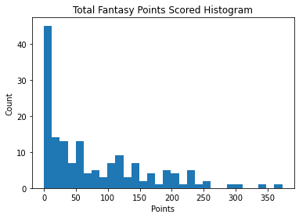
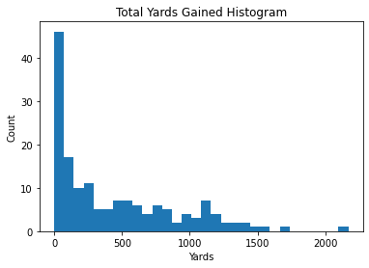
Distributions – Points and Yards
Mean: 77.9
Median: 49.8
Standard Deviation: 82.1
Mean: 440.2
Median: 267.0
Standard Deviation: 456.5

Slide 5
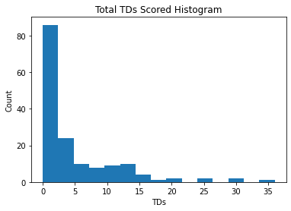
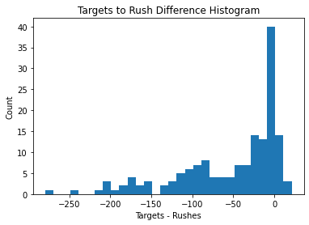
Distributions – TDs and Target-to-Rush Difference
Mean: 3.03
Median: 2.0
Standard Deviation: 4.0
Mean: -52.8
Median: -26.0
Standard Deviation: 62.9

Slide 6
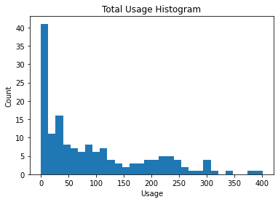
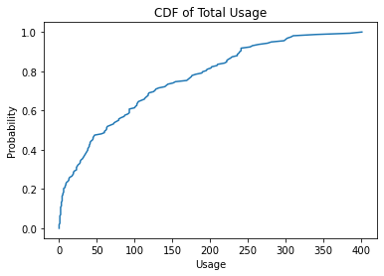
Distributions – Total Usage
Mean: 95.4
Median: 62.0
Standard Deviation: 96.6
CDF for Total Usage

Slide 7
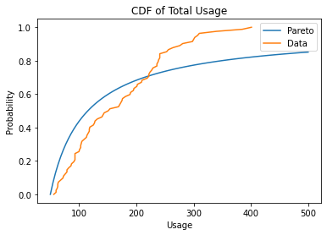
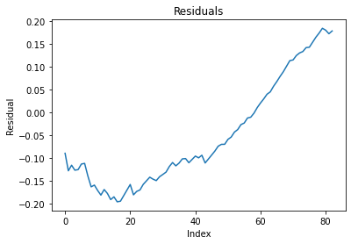
Analytical Plot – Total Usage
CDF of usage plotted over Pareto
Residuals

Slide 8
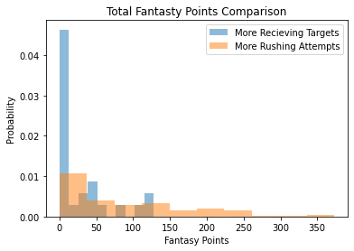
Comparison – Receiving vs Rushing Backs
Here I will compare the distribution of fantasy points for two groups of running backs, based on whether they get more passing targets than rushing attempts or the reverse.
We can see that the group that rushes more contains the most successful running backs.

Slide 9
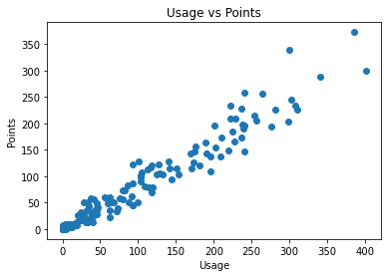
Scatter Plot – Usage and Points
Here we will look at the relationship between usage and points
R value: 0.97
R^2 value: 0.94
Usage is HIGHLY correlated to total fantasy points.

Slide 10
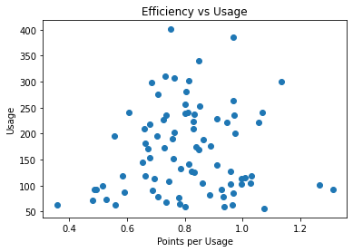
Hypothesis Test – Usage and Efficiency
Efficiency – number of points DIVIDED by total usage
R value: 0.08
P=0.24
P value is too high for this to be considered significant.

Slide 11
Regression Analysis – Fantasy Points
Total fantasy points is calculated as a combination of yards, touchdowns, and receptions.
Regression analysis can determine which of those three is most closely related to total fantasy points.
Determines which is most important in actually scoring the most points.
R^2 = 0.98, 0.86, and 0.80 for yards, touchdowns, and receptions, respectively.
Yards gained is most closely related to total points.

Slide 12
Thank You!

